Slide 1
Heat
Warmth and Coldness

Slide 2
Definitions
Heat
a measure of the energy transferred from a warm body to cooler body because of a difference in temperature
Temperature
a measure of the average kinetic energy of the atoms or molecules of a substance

Slide 3
Kinetic Molecular Theory
Matter – particles are always in motion
Thermal Energy – the total quantity of kinetic and potential energy possessed by the atoms or molecules of a substance.
As molecules vibrate more quickly, the object’s temperature increases

Slide 4
The Kelvin Scale
SI unit for temperature
based on the total amount of thermal energy that substances possess
lowest point = absolute zero (0 K)
0 K occurs at -273 ⁰C
TRY: p.273 #1,2
T_{C}=T_{K} – 273
T_{K}=T_{C} + 273

Slide 5
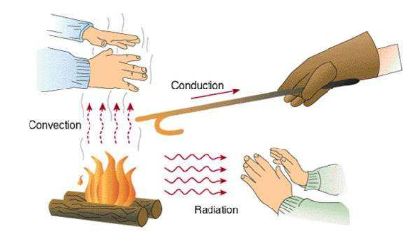
Methods of Heat Transfer
Heat transfers (moves) from a warmer body to a cooler body
3 ways that this can occur
Conduction
Convection
Radiation

Slide 6
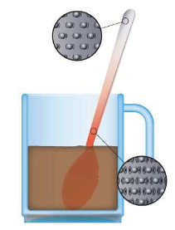
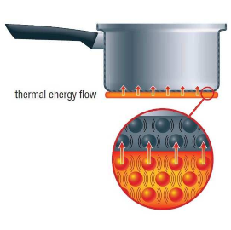
Conduction
Conduction
process by which the collision of atoms and electrons transfers heat through a material or between two materials in contact

Slide 7
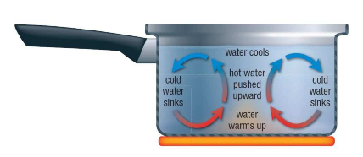
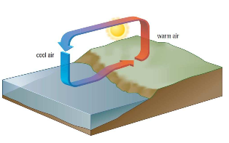
Convection
Convection
the process of transferring heat by a circulating path of fluid particles

Slide 8
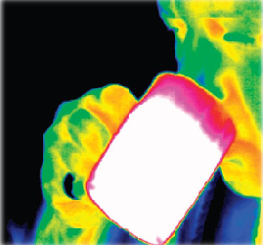
Radiation
Radiation
the process in which energy is transferred by means of electromagnetic waves

Slide 9
Radiation
process by which energy is transferred by electromagnetic waves
anything that is hot or warm is able to radiate heat

Slide 10
Homework
p. 273 #1 and 2
Read 6.2 and 6.3

